Slide 1
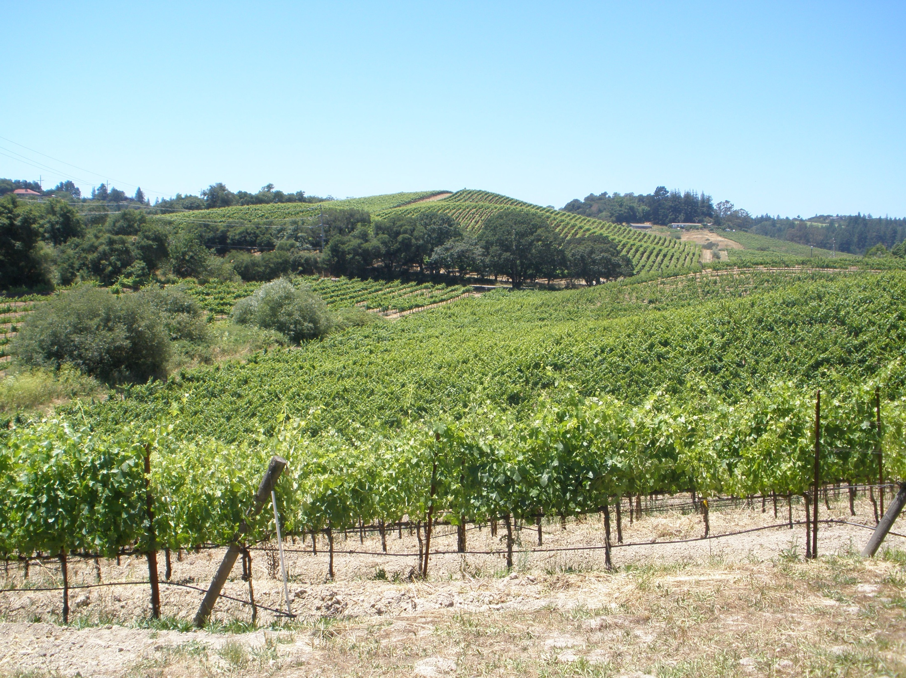

Alcoholic Beverage Classes Distilled Spirits 2017

Slide 2
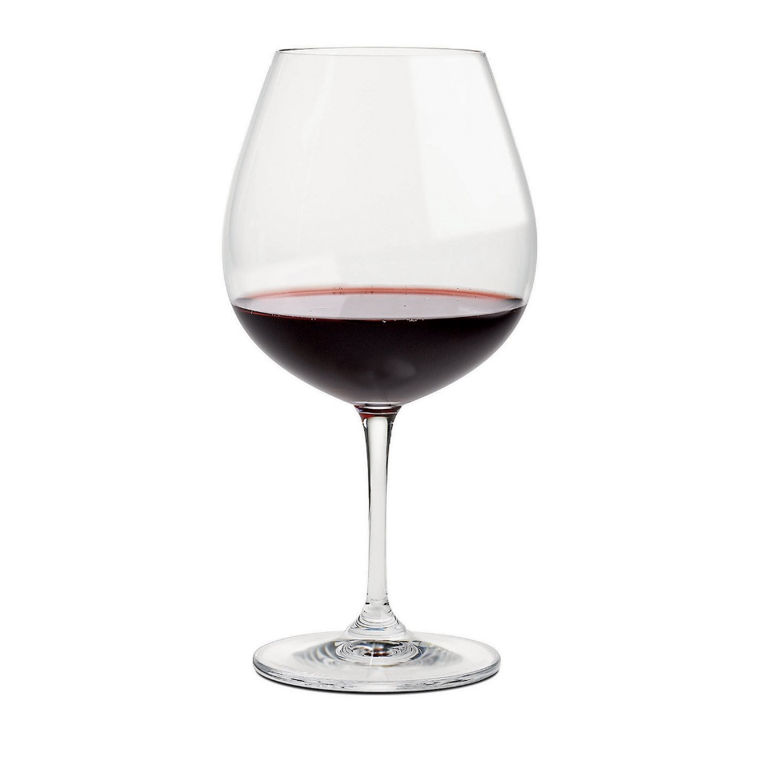
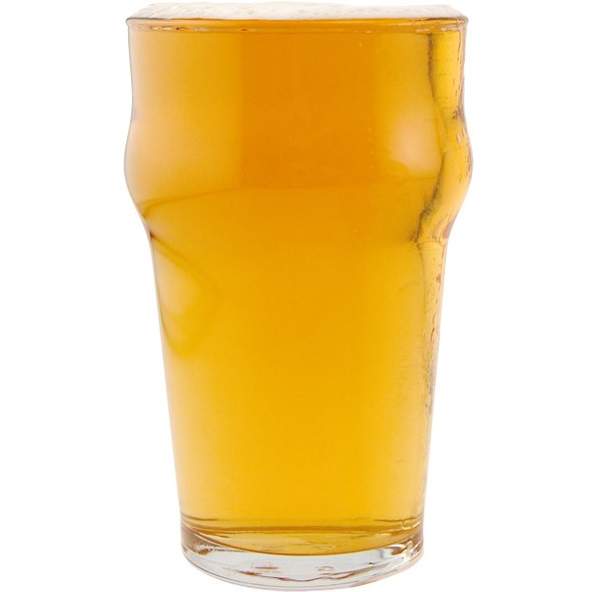
Spirits all start out in two ways
Wines
12-14% Alcohol
Beers
4-10% Alcohol
All Whisky and Scotch

Slide 3
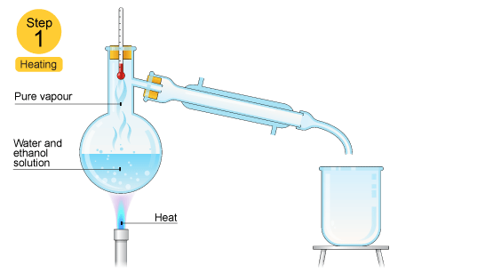
Distillation is the concentration of Alcohol
Alcohol vaporizes at 40 degrees less than water so the alcohol goes up in vapor leaving the water behind.

Slide 4
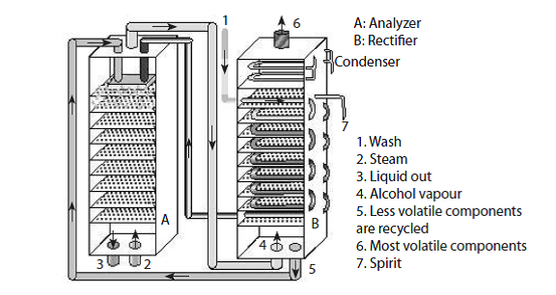
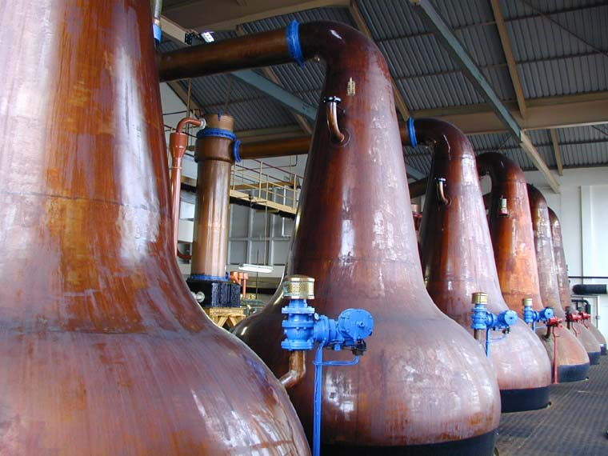
Distilled Spirits
Column, Coffey or Continuous
Grain Scotch and
Blended Scotch
Inexpensive, very efficient
Pot Still
Malt Scotch and
Vatted Malts
Labor intensive and inefficient

Slide 5
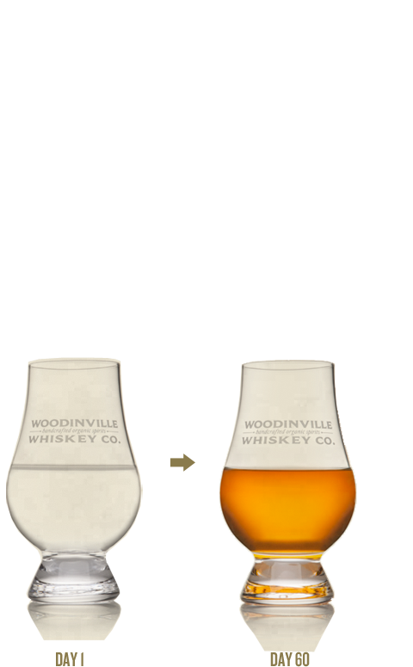
Distilled Spirits Virtually all the color comes from barrel aging
Many factors impact a whisky’s color
White (No Oak Aging)
Brown (Oak Aging)
Like all barrel aged spirits world wide most scotch is aged in used American Barrels, but younger barrels give more color
Temperature
Elevation
Latitude
What if anything was aging in the barrels before like sherry, port, or sauternes

Slide 6
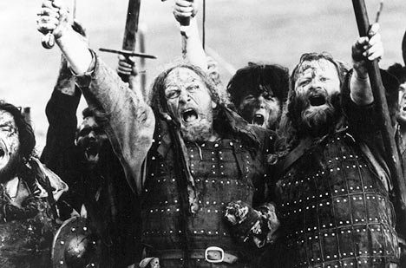
Scotch Whisky
Single Malt
Vatted Malt
Blended
Single Grain
Peat
Barley, Corn, Wheat, Rye
Water
Pot Stills
Barrels – Used Bourbon most common
Since 2007 must be bottled in Scotland

Slide 7
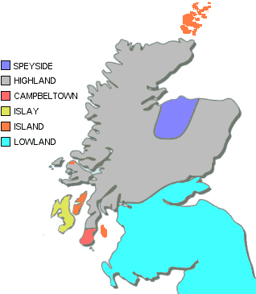
Single Malt Scotch Whisky
Must come from only one Distillery
Minimum 3 years aging
Pot Distilled (column stills are only allowed for blended and grain whiskey
Maximum distillation 65%
Only made from Barley

Slide 8
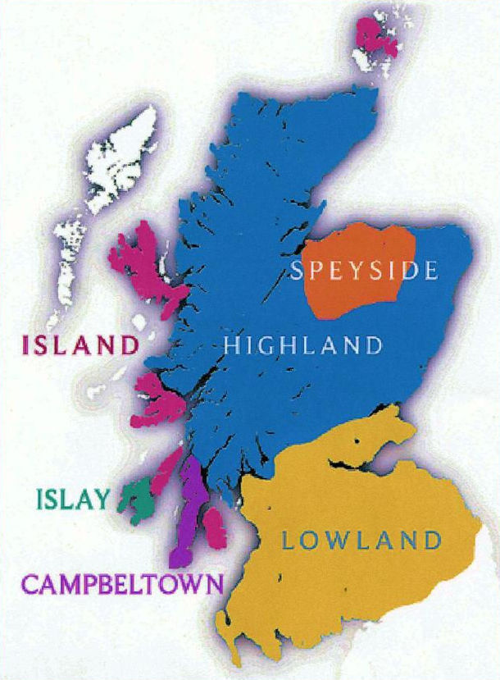
Scotch Whisky Regions
Highland (Perthshire, Speyside, Northern Highlands, Islands) Over 80
Islay 8 operating distilleries
Campeltown 3 distilleries but 6 labels
Lowland 16 Distilleries, 4 single malt, 4 grain distilleries, 8 are no longer producing

Slide 9
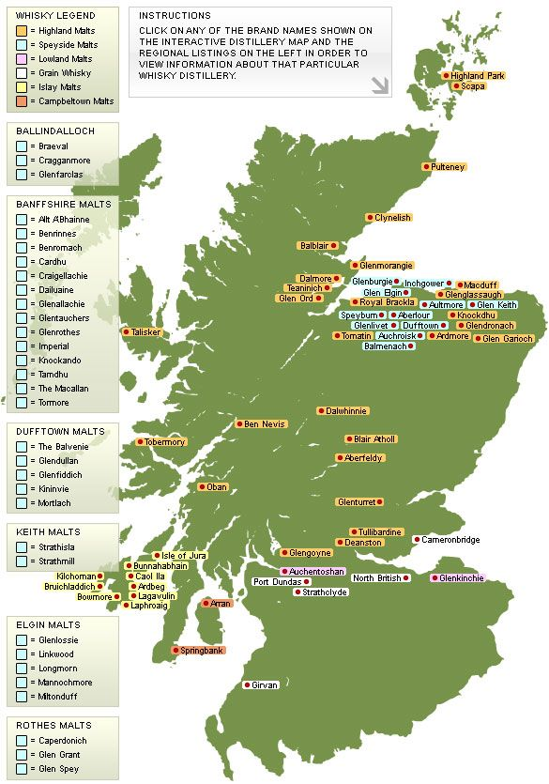
Inside the Highlands Eastern
Mainly forgotten about but can produce seaside malts without the peat
Glen Garioch
Lochnagar
Old Fettercairn
Glencadam
Draftmill
Cameronbridge -Grain
5 Ghost Distilleries

Slide 10
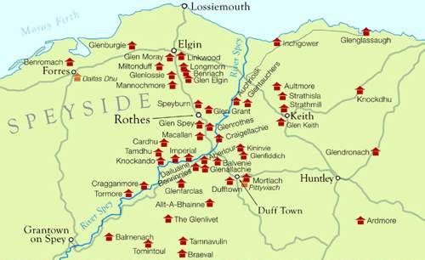
Inside the Highlands Speyside
Highest concentration of distilleries because of high concentration of natural springs with great water
Two styles
Light, grassy, low oak, before dinner, like Glenlivet
Heavy oak, sweet, with dinner, like Macallan

Slide 11
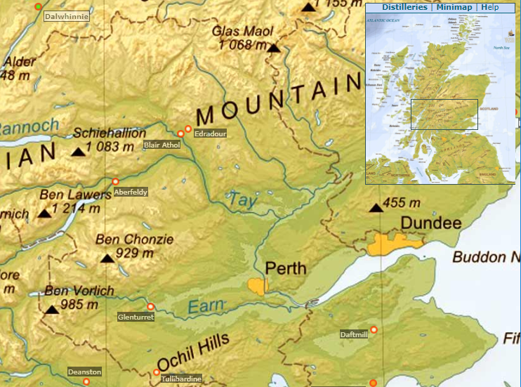
Inside the Highlands Perthshire
Aberfeldy
Edradour
Blair Athol
Deanston
Tullibardine
Glenturret
Strathern
Dalwhinne

Slide 12
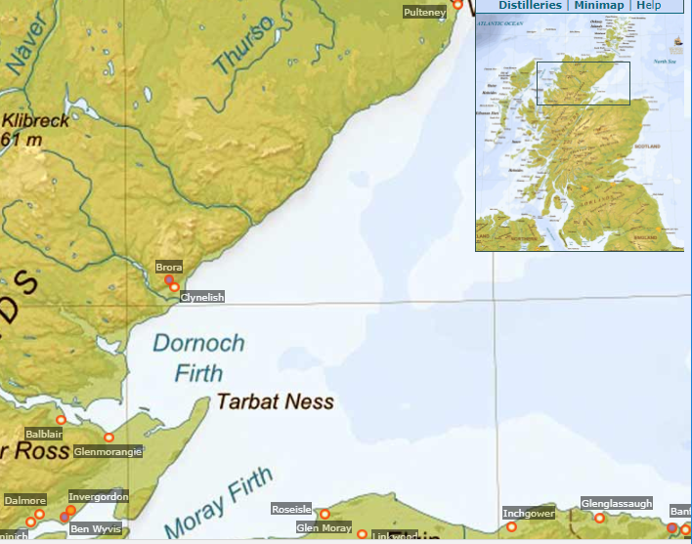
Inside the Highlands Northern
Pulteney
Brora
Clynelish
Balblair
Glemorangie
Dalmore
Invergordon
Ben Wyvris
Teaninich
Loch Ewe
(far west not pictured

Slide 13
Inside the Highlands Islands
Orkney
Highland Park
Scapa
Lewis
Abhainn Dearg
Skye
Talisker
Mull
Tobermory
Jura
Jura
Arran
Arran

Slide 14
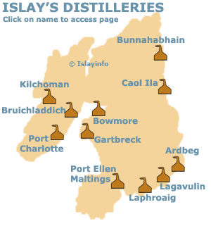
Islay the Island of Peat
Highest concentration of distilleries outside of Speyside
Ardbeg
Bowmore
Bruichladdich
Bunnahabhain
Caol Ila
Lagavulin
Laphroaig
Port Ellen - Ghost
Port Charlotte
Gartbreck – Starts 2017
Kilchoman

Slide 15
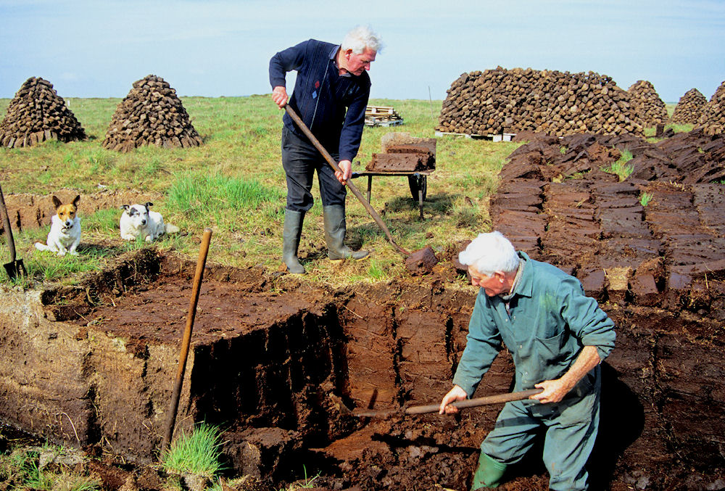
Peat
Peat is a compacted grass that can be burned for fuel. It was traditionally used in the malting rooms so the grains would have a very smoky flavor which would get into the whiskey. Because peat was used by the island distilleries, those brands are actually known for that smoky flavor.

Slide 16
Single Malt Scotch Whisky
Must come from only one Distillery
Minimum 3 years aging
Pot Distilled
Maximum distillation 65%
Only made from Barley

Slide 17
Single Malt Scotch Whisky
Must come from only one Distillery
Minimum 3 years aging
Pot Distilled
Maximum distillation 65%
Only made from Barley

Slide 18
Vatted Malt Scotch Whisky
Exactly the same as Single Malt but is a blend of single malts from multiple distilleries
Name cannot be bottled after 2009
Now must be botted as Blended Malt
The rarest of all scotch
Now only produced by independent bottlers
Johnnie Walker Green is rumored to be a vatted malt

Slide 19
Blended Scotch Whisky
Can be column or pot distilled
Barley, wheat, rye or corn
Must be aged 2 years in wood
Must be bottled in Scotland
Cannot be aged at more than 65%

Slide 20
Single Grain Scotch Whisky
Can be column or pot distilled but usually column or three times pot distilled
Barley, wheat, rye or corn
One grain must make up 80% or more of the mash
Must be aged 2 years in wood
Must be bottled in Scotland
Cannot be aged at more than 65%

Slide 21
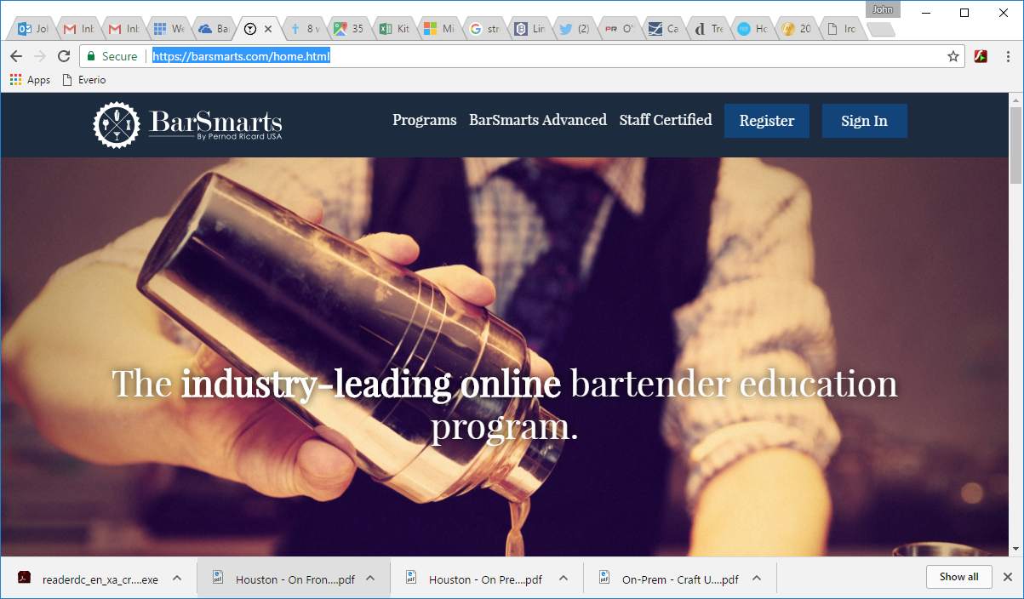
Further Study BarSmarts.com – Online and live bartender certifications.

Slide 22
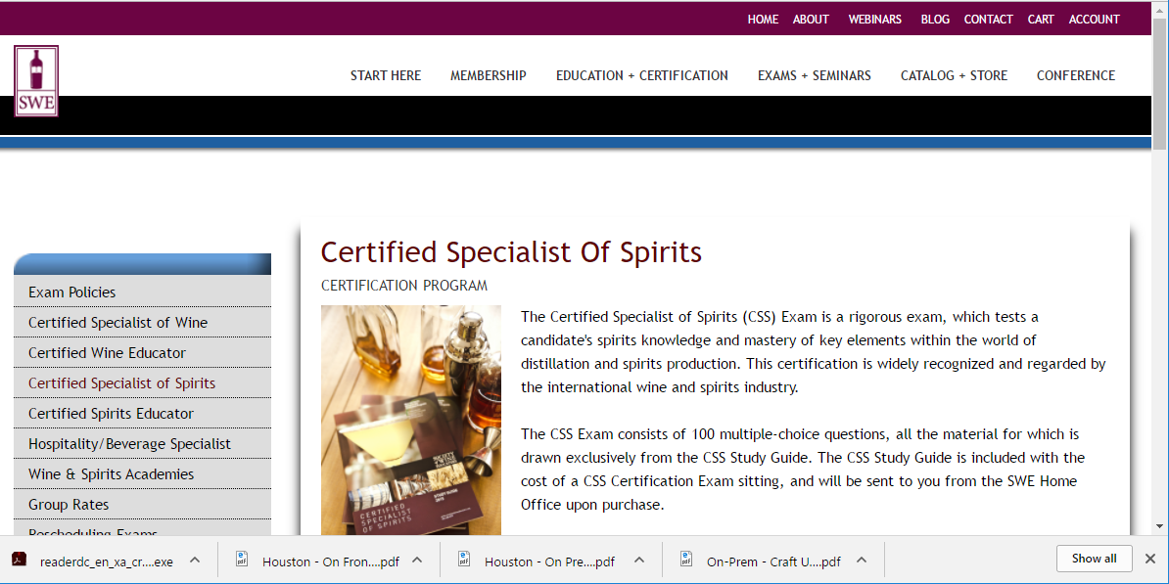
Further Study Certified Specialist of Spirits- SocietyOfWineEducators.org

Slide 23
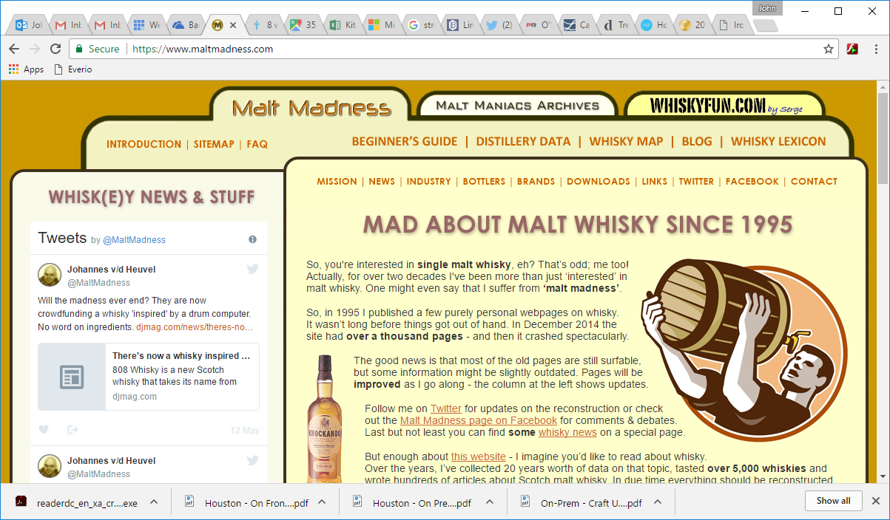
Further Study Scotch – MaltMadness.com

Slide 24
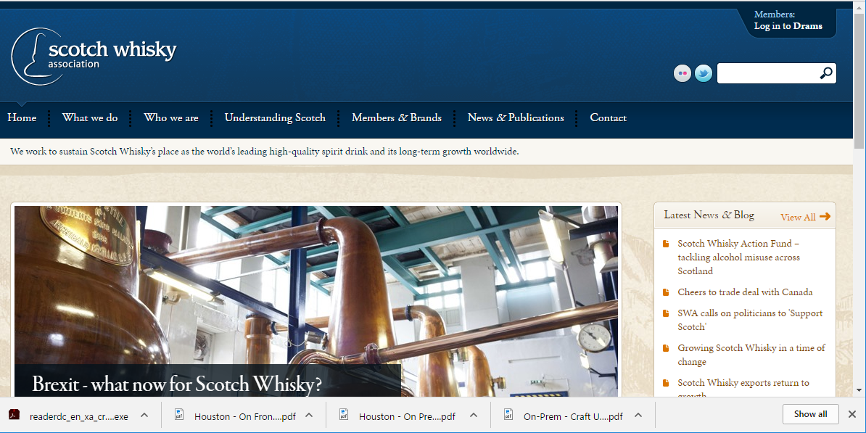
Further Study Scotch – Scotch Whisky Association

Slide 25
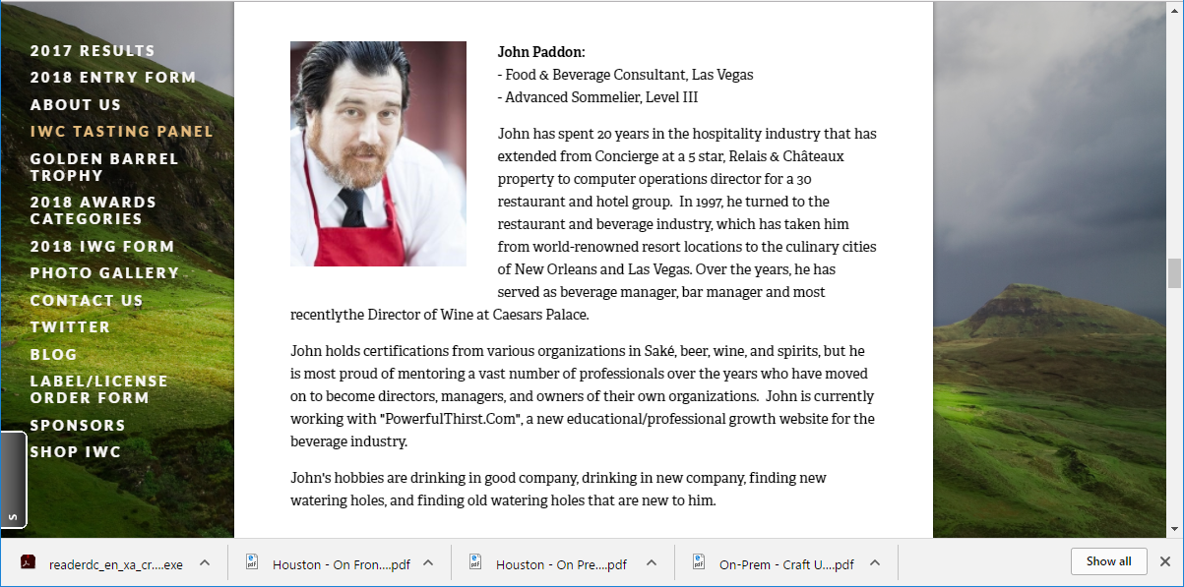
Further Study International Whisky Competition

